Slide 1
W4111 – Introduction to Databases Section 002, Spring 2025 Lecture 5: ER(4), Relational(4), SQL(4)
© Donald F. Ferguson, 2025

Slide 2

Today’s Contents
2 | COMS W4111_002_2025_1 - Lecture 6: ER(5), Relational(5), SQL(5) © Donald F. Ferguson, 2025

Slide 3
Contents
ER Modeling
TBD
Relational Algebra/Model
TBD
SQL
Some datatypes and functions – Examples
Indexes
Authorization
Window functions
Recursion
Worked example
Applications and Databases; Introduction to REST and web applications
Codd’s 12 Rules

Slide 4
ER Modeling
4 | COMS W4111_002_2025_1 - Lecture 5: ER(4), Relational(4), SQL(4) © Donald F. Ferguson, 2025

Slide 5
Relational Model
5 | COMS W4111_002_2025_1 - Lecture 5: ER(4), Relational(4), SQL(4) © Donald F. Ferguson, 2025

Slide 6
SQL
6 | COMS W4111_002_2025_1 - Lecture 5: ER(4), Relational(4), SQL(4) © Donald F. Ferguson, 2025

Slide 7

Some Types and Functions
7 | COMS W4111_002_2025_1 - Lecture 5: ER(4), Relational(4), SQL(4) © Donald F. Ferguson, 2025

Slide 8
Show Notebook

Slide 9
Indexes
9 | COMS W4111_002_2025_1 - Lecture 5: ER(4), Relational(4), SQL(4) © Donald F. Ferguson, 2025

Slide 10
Index Creation
Many queries reference only a small proportion of the records in a table.
It is inefficient for the system to read every record to find a record with particular value
An index on an attribute of a relation is a data structure that allows the database system to find those tuples in the relation that have a specified value for that attribute efficiently, without scanning through all the tuples of the relation.
We create an index with the create index command
create index <name> on <relation-name> (attribute);
SQL engines automatically create indexes for keys and constraints.
Identifying indexes to create requires understanding how users and applications will query the data. Indexes can have an exponential performance improvement.

Slide 11
Index Creation Example
create table student (ID varchar (5), name varchar (20) not null, dept_name varchar (20), tot_cred numeric (3,0) default 0, primary key (ID))
create index studentID_index on student(ID)
The query:
select * from student where ID = '12345'
can be executed by using the index to find the required record, without looking at all records of student
DFF:
An index on (column1, column2, column3)
Is also an index on (column1) and (column1, column2)
But not (column2), (column3), (column2, column3).
We will see “why” later in the semester.
Browse some schemas and discuss indexes:
DB Book
Lahman’s
IMDB

Slide 12
Authorization
12 | COMS W4111_002_2025_3 - Lecture 6: ER(5), Relational(5), SQL(5) © Donald F. Ferguson, 2025

Slide 13
Security Concepts (Terms from Wikipedia)
Definitions:
“A (digital) identity is information on an entity used by computer systems to represent an external agent. That agent may be a person, organization, application, or device.”
“Authentication is the act of proving an assertion, such as the identity of a computer system user. In contrast with identification, the act of indicating a person or thing's identity, authentication is the process of verifying that identity.”
“Authorization is the function of specifying access rights/privileges to resources, ... More formally, "to authorize" is to define an access policy. ... During operation, the system uses the access control rules to decide whether access requests from (authenticated) consumers shall be approved (granted) or disapproved.
“Within an organization, roles are created for various job functions. The permissions to perform certain operations are assigned to specific roles. Members or staff (or other system users) are assigned particular roles, and through those role assignments acquire the permissions needed to perform particular system functions.”
“In computing, privilege is defined as the delegation of authority to perform security-relevant functions on a computer system. A privilege allows a user to perform an action with security consequences. Examples of various privileges include the ability to create a new user, install software, or change kernel functions.”
SQL and relational database management systems implementing security by:
Creating identities and authentication policies.
Creating roles and assigning identities to roles.
Granting and revoking privileges to/from roles and identities.

Slide 14
Authorization
We may assign a user several forms of authorizations on parts of the database.
Read - allows reading, but not modification of data.
Insert - allows insertion of new data, but not modification of existing data.
Update - allows modification, but not deletion of data.
Delete - allows deletion of data.
Each of these types of authorizations is called a privilege. We may authorize the user all, none, or a combination of these types of privileges on specified parts of a database, such as a relation or a view.

Slide 15
Authorization (Cont.)
Forms of authorization to modify the database schema
Index - allows creation and deletion of indices.
Resources - allows creation of new relations.
Alteration - allows addition or deletion of attributes in a relation.
Drop - allows deletion of relations.

Slide 16
Authorization Specification in SQL
The grant statement is used to confer authorization
grant <privilege list> on <relation or view > to <user list>
<user list> is:
a user-id
public, which allows all valid users the privilege granted
A role (more on this later)
Example:
grant select on department to Amit, Satoshi
Granting a privilege on a view does not imply granting any privileges on the underlying relations.
The grantor of the privilege must already hold the privilege on the specified item (or be the database administrator).

Slide 17
Privileges in SQL
select: allows read access to relation, or the ability to query using the view
Example: grant users U₁, U₂, and U₃ select authorization on the instructor relation:
grant select on instructor to U₁, U₂, U₃
insert: the ability to insert tuples
update: the ability to update using the SQL update statement
delete: the ability to delete tuples.
all privileges: used as a short form for all the allowable privileges

Slide 18
Revoking Authorization in SQL
The revoke statement is used to revoke authorization.
revoke <privilege list> on <relation or view> from <user list>
Example:
revoke select on student from U₁, U₂, U₃
<privilege-list> may be all to revoke all privileges the revokee may hold.
If <revokee-list> includes public, all users lose the privilege except those granted it explicitly.
If the same privilege was granted twice to the same user by different grantees, the user may retain the privilege after the revocation.
All privileges that depend on the privilege being revoked are also revoked.

Slide 19
Roles
A role is a way to distinguish among various users as far as what these users can access/update in the database.
To create a role we use:
create a role <name>
Example:
create role instructor
Once a role is created we can assign “users” to the role using:
grant <role> to <users>

Slide 20
Roles Example
create role instructor;
grant instructor to Amit;
Privileges can be granted to roles:
grant select on takes to instructor;
Roles can be granted to users, as well as to other roles
create role teaching_assistant
grant teaching_assistant to instructor;
Instructor inherits all privileges of teaching_assistant
Chain of roles
create role dean;
grant instructor to dean;
grant dean to Satoshi;

Slide 21
Authorization on Views
create view geo_instructor as (select * from instructor where dept_name = 'Geology');
grant select on geo_instructor to geo_staff
Suppose that a geo_staff member issues
select * from geo_instructor;
What if
geo_staff does not have permissions on instructor?
Creator of view did not have some permissions on instructor?

Slide 22
Other Authorization Features
references privilege to create foreign key
grant reference (dept_name) on department to Mariano;
Why is this required?
transfer of privileges
grant select on department to Amit with grant option;
revoke select on department from Amit, Satoshi cascade;
revoke select on department from Amit, Satoshi restrict;
And more!
Note:
Like in many other cases, SQL DBMS have product specific variations.

Slide 23
Advanced Aggregation
Window Functions
23 | COMS W4111_002_2025_3 - Lecture 6: ER(5), Relational(5), SQL(5) © Donald F. Ferguson, 2025

Slide 24
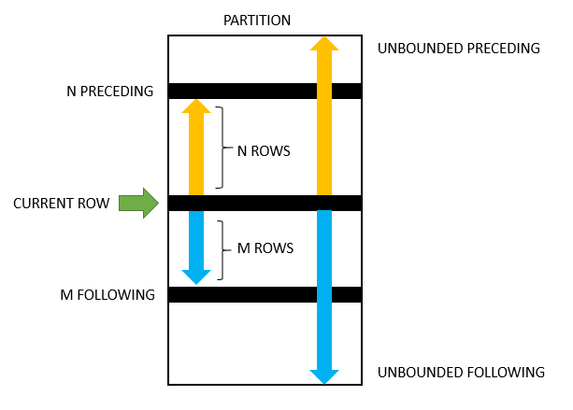
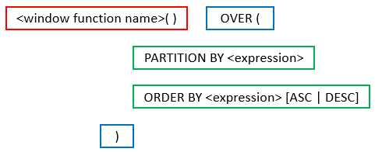
Advanced Aggregates and Window Functions
The aggregation functions in SQL are powerful.
There are some scenarios that are very difficult. SQL and databases add support for more advanced capabilities:
Ranking
Windows
Pivot, Slice and Dice, but we will cover these with a different technology (OLAP) later in the semester.
This is powerful, a little complex and requires trial and error.

Slide 25
Classic Models: Annual Revenue and YoY Growth by Country
SELECT country, YEAR(orderDate) AS year, ROUND(SUM(priceEach * quantityOrdered), 2) AS annual_revenue, ROUND( (SUM(priceEach * quantityOrdered) - LAG(SUM(priceEach * quantityOrdered)) OVER (PARTITION BY country ORDER BY YEAR(orderDate))) / LAG(SUM(priceEach * quantityOrdered)) OVER (PARTITION BY country ORDER BY YEAR(orderDate)) * 100, 2 ) AS yoy_growth_percentage FROM customers JOIN orders ON customers.customerNumber = orders.customerNumber JOIN orderdetails ON orders.orderNumber = orderdetails.orderNumber GROUP BY country, year ORDER BY country, year;

Slide 26
Revenue and Growth Quarter to Quarter
WITH quarterly_revenue AS (
SELECT
YEAR(o.orderDate) AS order_year, QUARTER(o.orderDate) AS order_quarter, SUM(od.quantityOrdered * od.priceEach) AS revenue
FROM
orders o JOIN orderdetails od ON o.orderNumber = od.orderNumber WHERE o.status = 'Shipped'
GROUP BY YEAR(o.orderDate), QUARTER(o.orderDate)
)
SELECT
qr.order_year, qr.order_quarter, qr.revenue,
LAG(qr.revenue) OVER (ORDER BY qr.order_year, qr.order_quarter) AS previous_quarter_revenue,
ROUND(
(qr.revenue - LAG(qr.revenue) OVER (ORDER BY qr.order_year, qr.order_quarter))
/ LAG(qr.revenue) OVER (ORDER BY qr.order_year, qr.order_quarter) * 100,
2
) AS qoq_growth_percent
FROM
quarterly_revenue qr
ORDER BY
qr.order_year, qr.order_quarter;

Slide 27
Recursive Queries
27 | COMS W4111_002_2025_1 - Lecture 6: ER(5), Relational(5), SQL(5) © Donald F. Ferguson, 2025

Slide 28
Recursion in SQL
SQL:1999 permits recursive view definition
Example: find which courses are a prerequisite, whether directly or indirectly, for a specific course with recursive rec_prereq(course_id, prereq_id) as ( select course_id, prereq_id from prereq union select rec_prereq.course_id, prereq.prereq_id, from rec_rereq, prereq where rec_prereq.prereq_id = prereq.course_id ) select ∗ from rec_prereq;
This example view, rec_prereq, is called the transitive closure of the prereq relation

Slide 29
The Power of Recursion
Recursive views make it possible to write queries, such as transitive closure queries, that cannot be written without recursion or iteration.
Intuition: Without recursion, a non-recursive non-iterative program can perform only a fixed number of joins of prereq with itself
This can give only a fixed number of levels of managers
Given a fixed non-recursive query, we can construct a database with a greater number of levels of prerequisites on which the query will not work
Alternative: write a procedure to iterate as many times as required
See procedure findAllPrereqs in book

Slide 30
The Power of Recursion
Computing transitive closure using iteration, adding successive tuples to rec_prereq
The next slide shows a prereq relation
Each step of the iterative process constructs an extended version of rec_prereq from its recursive definition.
The final result is called the fixed point of the recursive view definition.
Recursive views are required to be monotonic. That is, if we add tuples to prereq the view rec_prereq contains all of the tuples it contained before, plus possibly more
This is from the book.
There is a typo in the query.
I cannot figure out what they are trying to accomplish.
The data is not complex enough to justify recursion. See the following example.

Slide 31
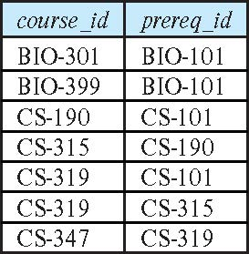
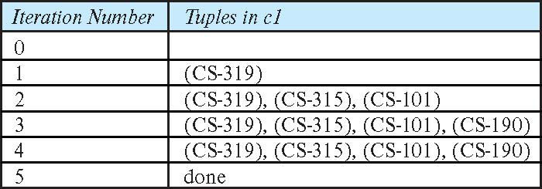
Example of Fixed-Point Computation

Slide 32
Classic Models Management Chain
WITH RECURSIVE employee_chain AS ( -- Base case: Start with employees who do not report to anyone (top-level managers) SELECT employeeNumber AS employee_id, reportsTo AS manager_id, CONCAT(firstName, ' ', lastName) AS employee_name, CAST(employeeNumber AS CHAR(100)) AS management_chain FROM employees WHERE reportsTo IS NULL UNION ALL -- Recursive step: Add employees who report to employees already in the chain SELECT e.employeeNumber AS employee_id, e.reportsTo AS manager_id, CONCAT(e.firstName, ' ', e.lastName) AS employee_name, CONCAT(ec.management_chain, ' -> ', e.employeeNumber) AS management_chain FROM employees e JOIN employee_chain ec ON e.reportsTo = ec.employee_id ) SELECT employee_id, employee_name, management_chain FROM employee_chain ORDER BY management_chain;

Slide 33

Recursive Query

Slide 34
Let’s Put Some Pieces Together Specialization
Procedures, Functions, Triggers
Authorization
34 | COMS W4111_002_2025_1 - Lecture 6: ER(5), Relational(5), SQL(5) © Donald F. Ferguson, 2025

Slide 35
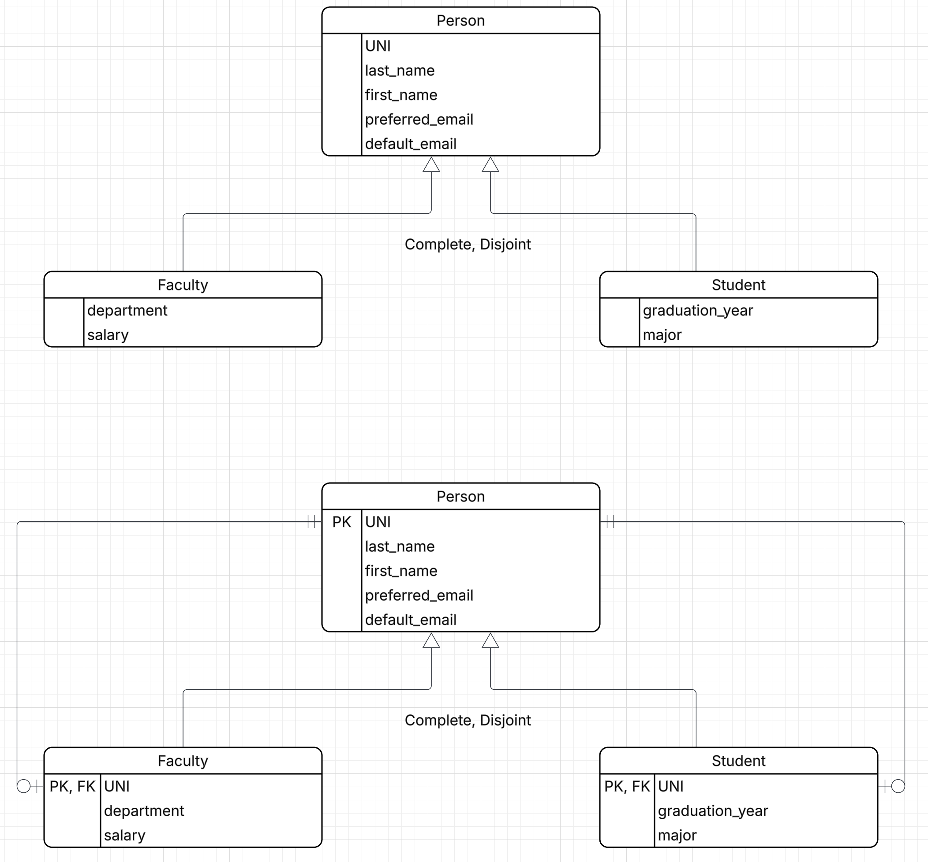
Specialization
We will use a 3-Table Solution
UNI must be globally unique PK
Complete ➔
You create a Faculty or a Student
But, this requires inserting into two tables.
So, we will use Procedures
preferred_email is Unique. Default email is autogenerated.
Salary is sensitive information; We will control access.
That seems like enough fun for now.
Logical Model
3-Table Solution

Slide 36
What Have We Seen?
A partial implementation of specialization putting pieces together:
3-table solution
Views
The use of procedures, including allowing a user to perform operations that cannot call directly because the procedure runs “as definer.”
Functions
This is only a partial implementation to a contrived scenario.
Why would I let general_user set a salary on create but not query it.
I should add some triggers, for example to prevent changing UNI.
Additional views?
Additional procedures, e.g. for update and delete
… …
You will do a more complete implementation of an alternate scenario on HW 3.

Slide 37
Applications and Databases Web Applications and REST
37 | COMS W4111_002_2025_1 - Lecture 5: ER(4), Relational(4), SQL(4) © Donald F. Ferguson, 2025

Slide 38
Introduction
Introduction
38 | COMS W4111_002_2025_1 - Lecture 6: ER(5), Relational(5), SQL(5) © Donald F. Ferguson, 2025

Slide 39
Accessing SQL from a Programming Language
A database programmer must have access to a general-purpose programming language for at least two reasons
Not all queries can be expressed in SQL, since SQL does not provide the full expressive power of a general-purpose language.
Non-declarative actions -- such as printing a report, interacting with a user, or sending the results of a query to a graphical user interface -- cannot be done from within SQL.
Entering an address is an example that I use in my cloud computing course.

Slide 40
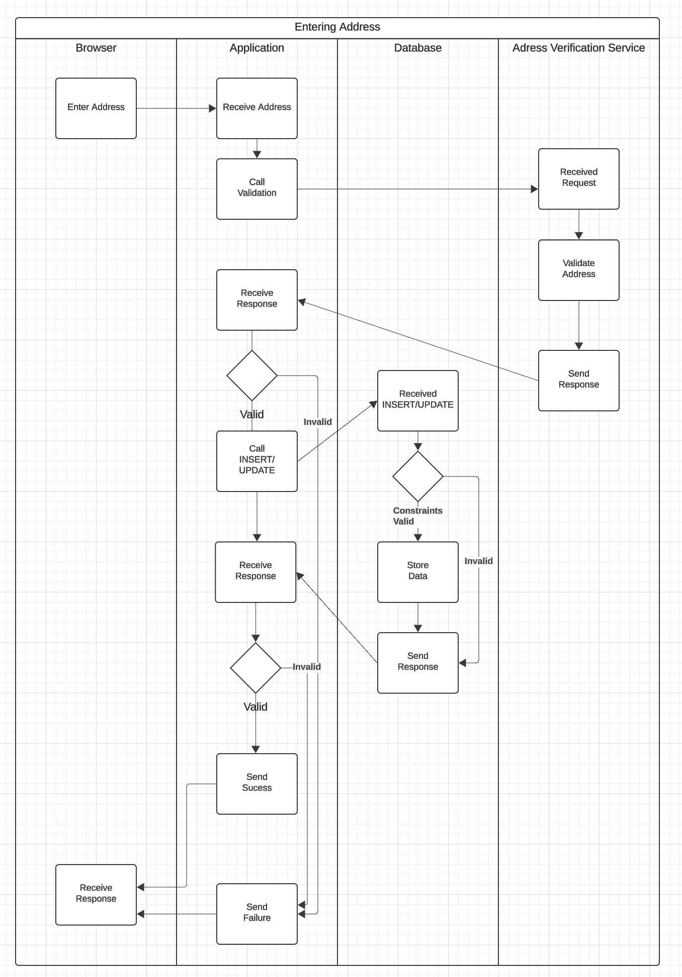
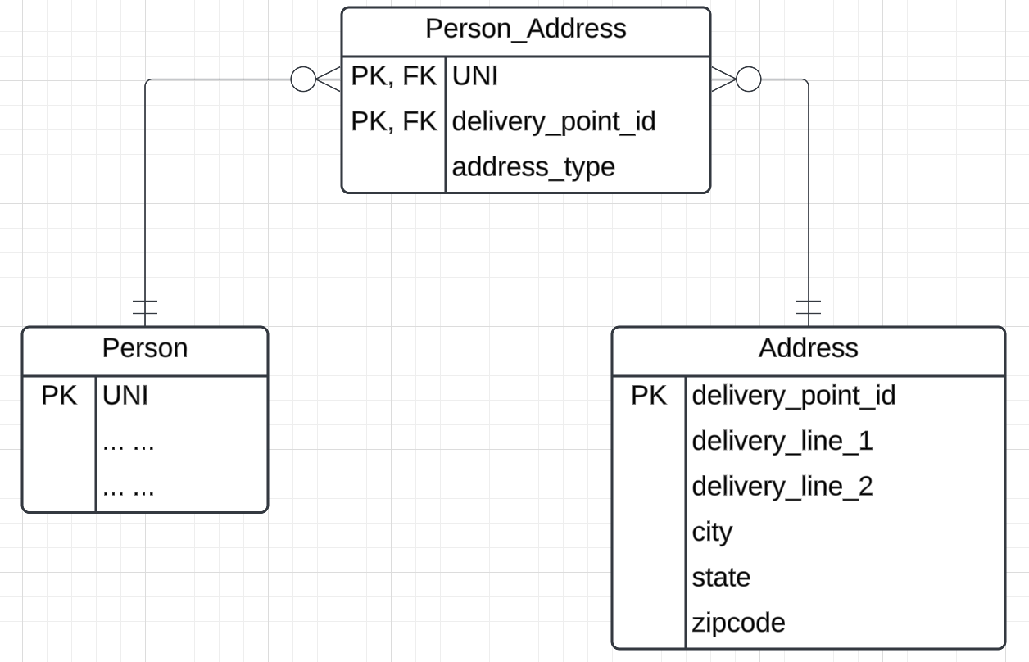
User Profile
Why application logic? An example.
People are notoriously bad at entering addresses:
520 w120th street, ny ny
520 West 120th, NYC, NY
520 w 120 street, New York city, NY
… …
Every address has a canonical format.
I want to call a cloud-based address verification service or some other validations.
Complex, multi-database application logic is very hard to write in SQL.
“Logic” in the database should focus on integrity of the data, not general purpose, complex application behavior.

Slide 41
Accessing SQL from a Programming Language (Cont.)
There are two approaches to accessing SQL from a general-purpose programming language
A general-purpose program -- can connect to and communicate with a database server using a collection of functions
Embedded SQL -- provides a means by which a program can interact with a database server.
The SQL statements are translated at compile time into function calls.
At runtime, these function calls connect to the database using an API that provides dynamic SQL facilities.

Slide 42
Some Terms
“A database connection is a facility in computer science that allows client software to talk to database server software, whether on the same machine or not. A connection is required to send commands and receive answers, usually in the form of a result set.” (https://en.wikipedia.org/wiki/Database_connection)
Session:
“Connection is the relationship between a client and a MySQL database. Session is the period of time between a client logging in (connecting to) a MySQL database and the client logging out (exiting) the MySQL database.” (https://stackoverflow.com/questions/8797724/mysql-concepts-session-vs-connection)
“A session is just a result of a successful connection.”
Network protocols are layered. You can think of:
Connection as the low-level network connection.
Session is the next layer up and has additional information associated with it, e.g. the user.
Connection libraries like pymysql sometimes blur the distinction.

Slide 43
Concepts
MySQL Workbench
… … … …
DataGrip
Relational Database Management System Instance
Blocks Files Records Offsets … …
SQL commands and result sets flow over connection in a session.
Jupyter Notebook
Logically implements query, update, insert, delete, … operations on tables.
Physical layout managed by the DBMS is not tables and is very different.
Web Application
… …
… …

Slide 44

Simplistic View
Your Application Code
Your Application Code
Execute(“Some SQL Statement”)
General DBMS Runtime Including Networking
Language Binding/ Connector
Worked Task with User ID/Role
Native Connector mysqlconnector
TCP/IP
Network Messages
Operating System

Slide 45
Transactions
A transaction consists of a sequence of query and/or update statements and is a “unit” of work
The SQL standard specifies that a transaction begins implicitly when an SQL statement is executed.
The transaction must end with one of the following statements:
Commit work. The updates performed by the transaction become permanent in the database.
Rollback work. All the updates performed by the SQL statements in the transaction are undone.
Atomic transaction
either fully executed or rolled back as if it never occurred
Isolation from concurrent transactions
Show connecting
Explain auto-commit

Slide 46
REST and Web Applications
Introduction
46 | COMS W4111_002_2025_1 - Lecture 6: ER(5), Relational(5), SQL(5) © Donald F. Ferguson, 2025

Slide 47
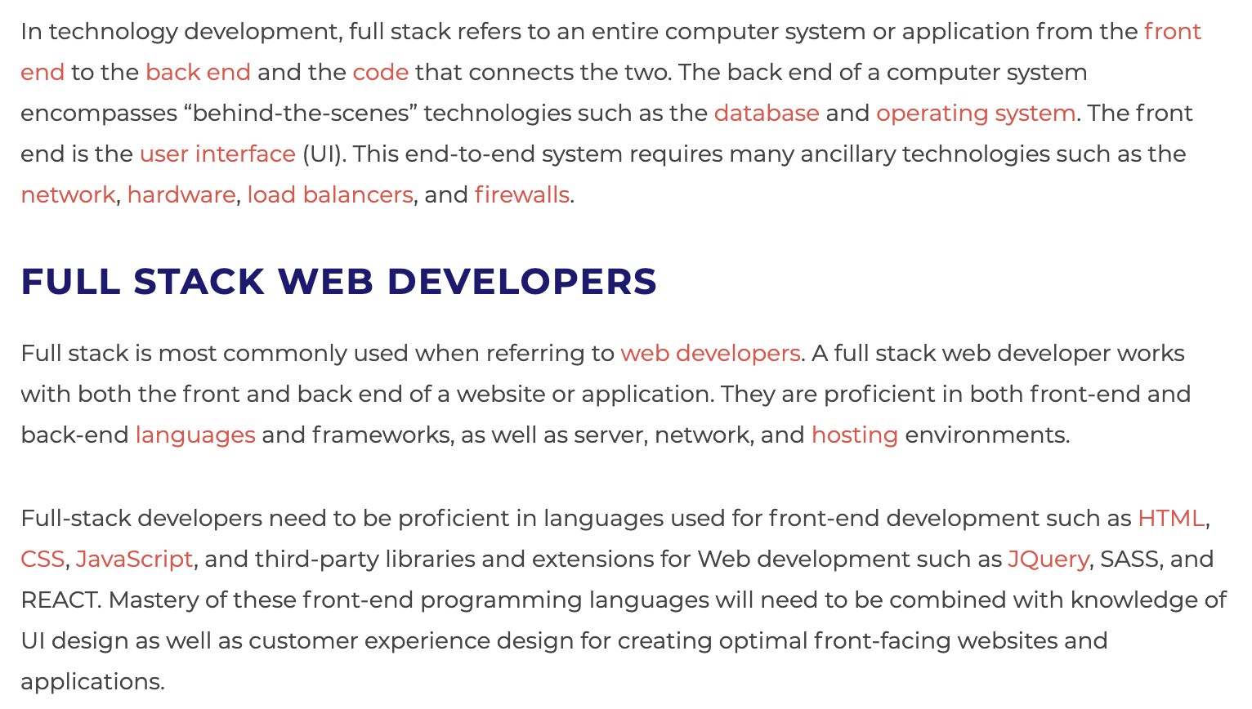
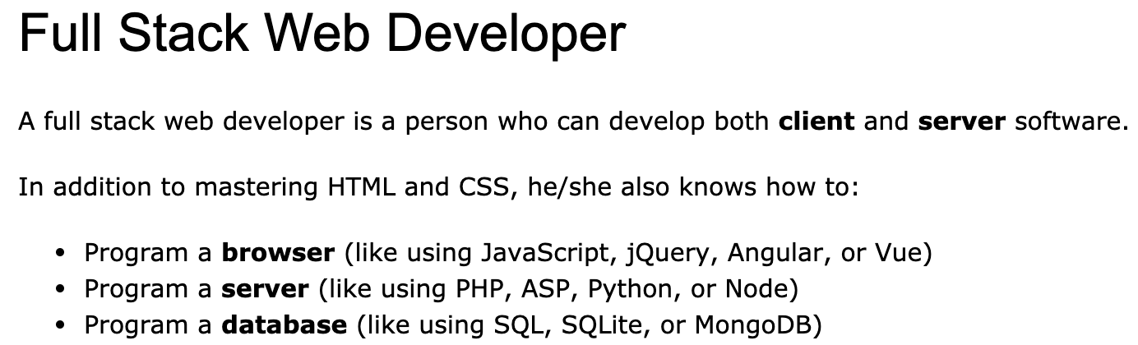
Full Stack Application
https://www.w3schools.com/whatis/whatis_fullstack.asp
There are courses that cover topics:
COMS W4153: Advanced Software Engineering
COMS W4111: Introduction to Databases
COMS W4170 - User Interface Design
This course will focus on cloud realization, microservices and application patterns, ... ...
Also, I am not great at UIs ... ... We will not emphasize or require a lot of UI work.
https://www.webopedia.com/definitions/full-stack/

Slide 48
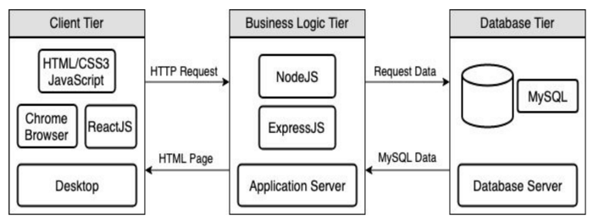
Full Stack Web Application
M = Mongo
E = Express
R = React
N = Node
I start with FastAPI and MySQL, but all the concepts are the same.
https://levelup.gitconnected.com/a-complete-guide-build-a-scalable-3-tier-architecture-with-mern-stack-es6-ca129d7df805
My preferences are to replace React with Angular, and Node with FastAPI.
There are three projects to design, develop, test, deploy, ... ...
Browser UI application.
Microservice.
Database.
The programming track will implement a simple web application to access IMDB and Game of Thrones data.

Slide 49
Some Terms
A web application server or web application framework: “A web framework (WF) or web application framework (WAF) is a software framework that is designed to support the development of web applications including web services, web resources, and web APIs. Web frameworks provide a standard way to build and deploy web applications on the World Wide Web. Web frameworks aim to automate the overhead associated with common activities performed in web development. For example, many web frameworks provide libraries for database access, templating frameworks, and session management, and they often promote code reuse.” (https://en.wikipedia.org/wiki/Web_framework)
REST: “REST (Representational State Transfer) is a software architectural style that was created to guide the design and development of the architecture for the World Wide Web. REST defines a set of constraints for how the architecture of a distributed, Internet-scale hypermedia system, such as the Web, should behave. The REST architectural style emphasises uniform interfaces, independent deployment of components, the scalability of interactions between them, and creating a layered architecture to promote caching to reduce user-perceived latency, enforce security, and encapsulate legacy systems.[1] REST has been employed throughout the software industry to create stateless, reliable web-based applications.” (https://en.wikipedia.org/wiki/REST)

Slide 50
Some Terms
OpenAPI: “The OpenAPI Specification, previously known as the Swagger Specification, is a specification for a machine-readable interface definition language for describing, producing, consuming and visualizing web services.” (https://en.wikipedia.org/wiki/OpenAPI_Specification)
Model: “A model represents an entity of our application domain with an associated type.” (https://medium.com/@nicola88/your-first-openapi-document-part-ii-data-model-52ee1d6503e0)
Routers: “What fastapi docs says about routers: If you are building an application or a web API, it’s rarely the case that you can put everything on a single file. FastAPI provides a convenience tool to structure your application while keeping all the flexibility.” (https://medium.com/@rushikeshnaik779/routers-in-fastapi-tutorial-2-adf3e505fdca)
Summary:
These are general concepts, and we will go into more detail in the semester.
FastAPI is a specific technology for Python.
There are many other frameworks applicable to Python, NodeJS/TypeScript, Go, C#, Java, … …
They all surface similar concepts with slightly different names.

Slide 51
REST and Resources

Slide 52
REST (https://restfulapi.net/)
What is REST
REST is acronym for REpresentational State Transfer. It is architectural style for distributed hypermedia systems and was first presented by Roy Fielding in 2000 in his famous dissertation.
Like any other architectural style, REST also does have it’s own 6 guiding constraints which must be satisfied if an interface needs to be referred as RESTful. These principles are listed below.
Guiding Principles of REST
Client–server – By separating the user interface concerns from the data storage concerns, we improve the portability of the user interface across multiple platforms and improve scalability by simplifying the server components.
Stateless – Each request from client to server must contain all of the information necessary to understand the request, and cannot take advantage of any stored context on the server. Session state is therefore kept entirely on the client.
Cacheable – Cache constraints require that the data within a response to a request be implicitly or explicitly labeled as cacheable or non-cacheable. If a response is cacheable, then a client cache is given the right to reuse that response data for later, equivalent requests.
Uniform interface – By applying the software engineering principle of generality to the component interface, the overall system architecture is simplified and the visibility of interactions is improved. In order to obtain a uniform interface, multiple architectural constraints are needed to guide the behavior of components. REST is defined by four interface constraints: identification of resources; manipulation of resources through representations; self-descriptive messages; and, hypermedia as the engine of application state.
Layered system – The layered system style allows an architecture to be composed of hierarchical layers by constraining component behavior such that each component cannot “see” beyond the immediate layer with which they are interacting.
Code on demand (optional) – REST allows client functionality to be extended by downloading and executing code in the form of applets or scripts. This simplifies clients by reducing the number of features required to be pre-implemented.

Slide 53
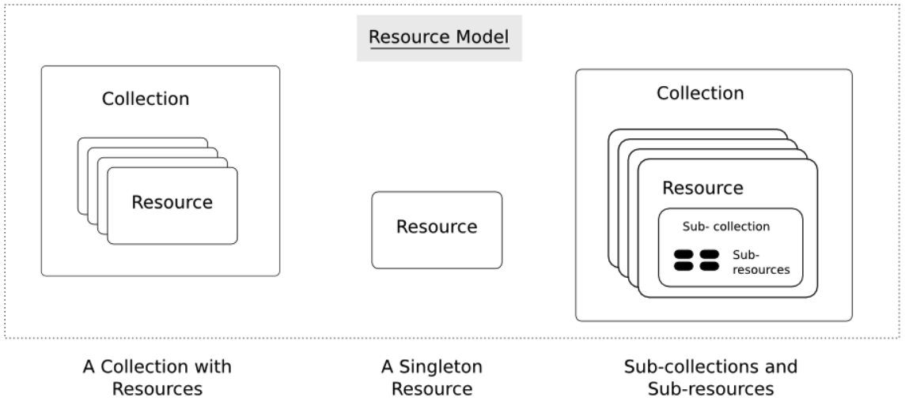
Resources
Resources are an abstraction. The application maps to create things and actions.
“A resource-oriented API is generally modeled as a resource hierarchy, where each node is either a simple resource or a collection resource. For convenience, they are often called a resource and a collection, respectively.
A collection contains a list of resources of the same type. For example, a user has a collection of contacts.
A resource has some state and zero or more sub-resources. Each sub-resource can be either a simple resource or a collection resource.
For example, Gmail API has a collection of users, each user has a collection of messages, a collection of threads, a collection of labels, a profile resource, and several setting resources.
While there is some conceptual alignment between storage systems and REST APIs, a service with a resource-oriented API is not necessarily a database, and has enormous flexibility in how it interprets resources and methods. For example, creating a calendar event (resource) may create additional events for attendees, send email invitations to attendees, reserve conference rooms, and update video conference schedules. (Emphasis added) (https://cloud.google.com/apis/design/resources#resources)
https://restful-api-design.readthedocs.io/en/latest/resources.html

Slide 54
REST – Resource Oriented
When writing applications, we are used to writing functions or methods:
openAccount(last_name, first_name, tax_payer_id)
account.deposit(deposit_amount)
account.close()
We can create and implement whatever functions we need.
REST only allows four methods:
POST: Create a resource
GET: Retrieve a resource
PUT: Update a resource
DELETE: Delete a resource
That’s it. That’s all you get.
A REST client needs no prior knowledge about how to interact with any particular application or server beyond a generic understanding of hypermedia.
“The key characteristic of a resource-oriented API is that it emphasizes resources (data model) over the methods performed on the resources (functionality). A typical resource-oriented API exposes a large number of resources with a small number of methods.” (https://cloud.google.com/apis/design/resources)

Slide 55
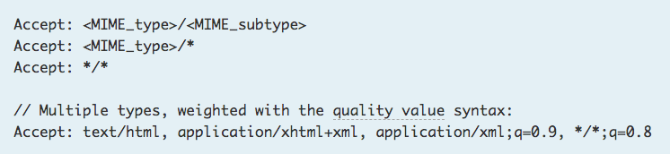
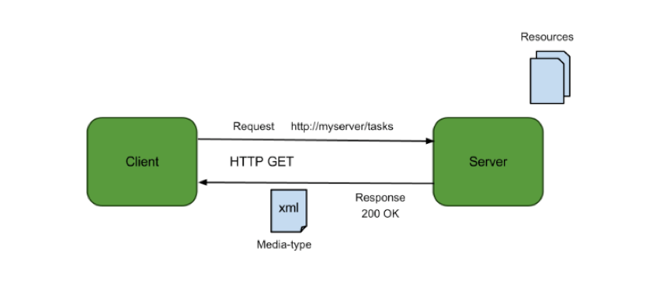
Resources, URLs, Content Types
Relative URL identifies “resource” on the server.
Server implementation maps abstract resource to tangible “thing,” file, DB row, … and any application logic.
Accept type in headers.
Client may be
Browser
Mobile device
Other REST Service
… …
Web media (content) type, e.g.
text/html
application/json

Slide 56
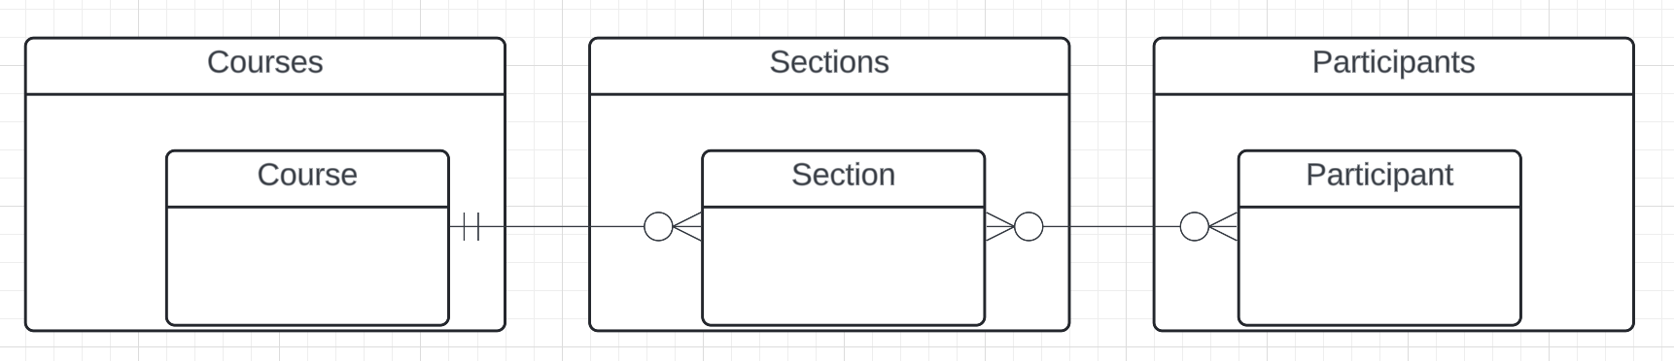
Resources and APIs
Base resources, paths and methods:
/courses: GET, POST
/courses/<id>: GET, PUT, DELETE
/sections: GET, POST
/sections/<id>: GET, PUT, DELETE
/participants: GET, POST
/participants/<id>: GET, PUT, DELETE
There are relative, navigation paths:
/courses/<id>/sections
/participants/<id>/sections
etc.
GET on resources that are collections may also have query parameters.
There are two approaches to defining API
Start with OpenAPI document and produce an implementation template.
Start with annotated code and generate API document.
In either approach, I start with models.
Also,
I lack the security permission to update CourseWorks.
I can choose to not surface the methods or raise and exception.

Slide 57
Data Modeling Concepts and REST
Almost any data model has the same core concepts:
Types and instances:
Entity Type: A definition of a type of thing with properties and relationships.
Entity Instance: A specific instantiation of the Entity Type
Entity Set Instance: An Entity Type that:
Has properties and relationships like any entity, but ...
Has at least one special relationship – contains.
Operations, minimally CRUD, that manipulate entity types and instances:
Create
Retrieve
Update
Delete
Reference/Identify/... ...
Host/database/table/pk

Slide 58
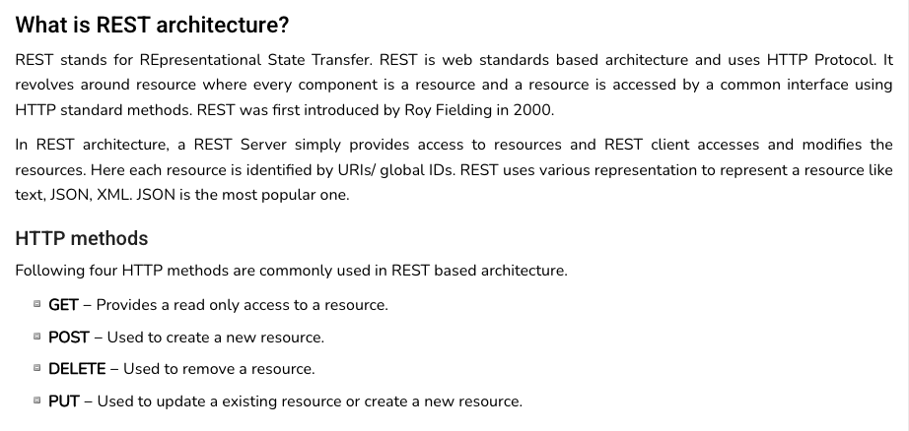
REST (https://www.tutorialspoint.com/restful/restful_introduction.htm)

Slide 59
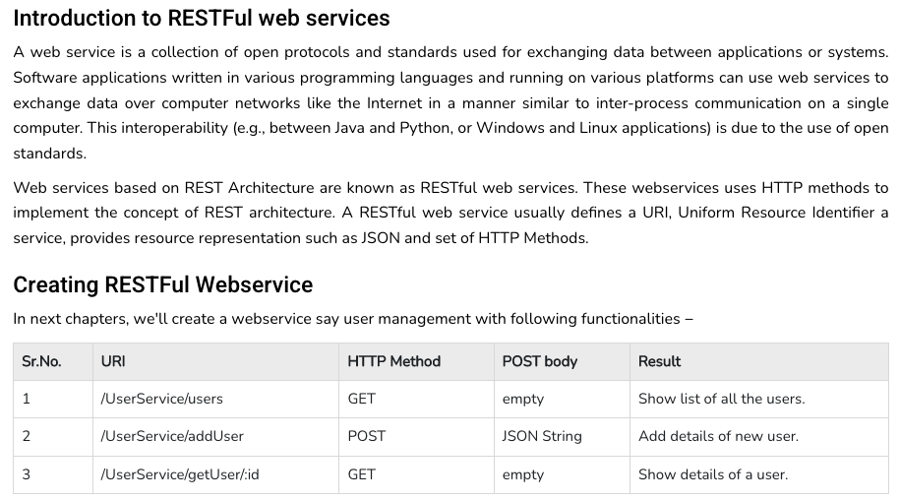
REST (https://www.tutorialspoint.com/restful/restful_introduction.htm)

Slide 60
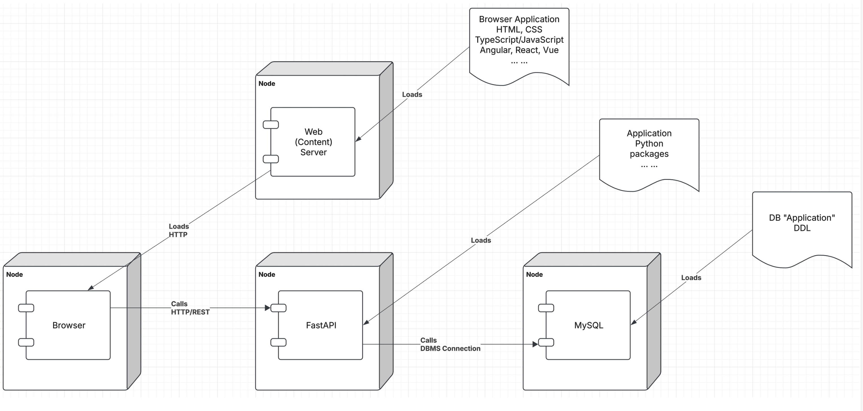
Let’s Look at the Programming Project

Slide 61
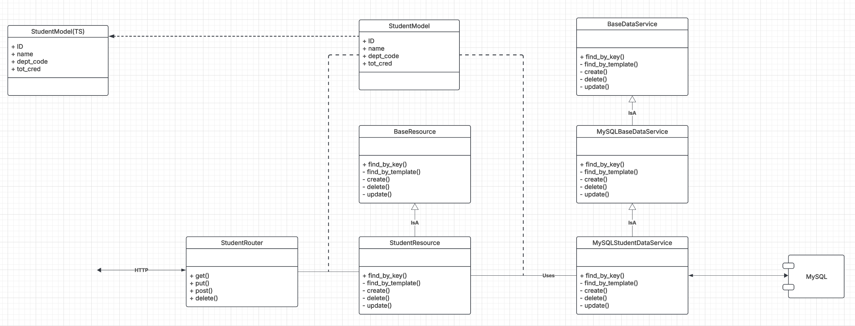
Let’s Look at the Programming Project

Slide 62
URLs

Slide 63
Simplistic, Conceptual Mapping (Examples)
REST Method | Resource Path | Relational Operation | DB Resource
DELETE | /people | DROP TABLE | people table
POST | /people | INSERT INTO PEOPLE (...) VALUES(...) | people table people row
GET | /people/21 | SHOW KEYS FROM people ...; SELECT * FROM people WHERE playerID= 21 | people row
GET | /people/21/batting | SELECT batting.* FROM people JOIN batting USING(playerID) WHERE playerID=21
GET | /people/21/batting/2004_1 | SELECT batting.* FROM people JOIN batting USING(playerID) WHERE playerID=21 AND yearID=2004 AND stint=1

Slide 64
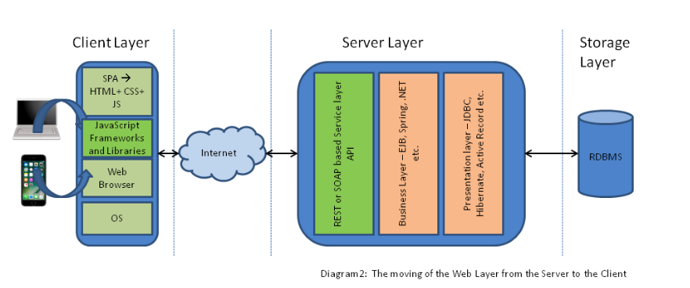
Application Architecture

Slide 65
Codd’s 12 Rules
65 | COMS W4111_002_2025_1 - Lecture 6: ER(5), Relational(5), SQL(5) © Donald F. Ferguson, 2025

Slide 66
Codd’s 12 Rules
Rule 1: Information Rule
The data stored in a database, may it be user data or metadata, must be a value of some table cell. Everything in a database must be stored in a table format.
Rule 2: Guaranteed Access Rule
Every single data element (value) is guaranteed to be accessible logically with a combination of table-name, primary-key (row value), and attribute-name (column value). No other means, such as pointers, can be used to access data.
Rule 3: Systematic Treatment of NULL Values
The NULL values in a database must be given a systematic and uniform treatment. This is a very important rule because a NULL can be interpreted as one the following − data is missing, data is not known, or data is not applicable.
Rule 4: Active Online Catalog
The structure description of the entire database must be stored in an online catalog, known as data dictionary, which can be accessed by authorized users. Users can use the same query language to access the catalog which they use to access the database itself.
Rule 5: Comprehensive Data Sub-Language Rule
A database can only be accessed using a language having linear syntax that supports data definition, data manipulation, and transaction management operations. This language can be used directly or by means of some application. If the database allows access to data without any help of this language, then it is considered as a violation.
Rule 6: View Updating Rule
All the views of a database, which can theoretically be updated, must also be updatable by the system.

Slide 67
Codd’s 12 Rules
Rule 7: High-Level Insert, Update, and Delete Rule
A database must support high-level insertion, updation, and deletion. This must not be limited to a single row, that is, it must also support union, intersection and minus operations to yield sets of data records.
Rule 8: Physical Data Independence
The data stored in a database must be independent of the applications that access the database. Any change in the physical structure of a database must not have any impact on how the data is being accessed by external applications.
Rule 9: Logical Data Independence
The logical data in a database must be independent of its user’s view (application). Any change in logical data must not affect the applications using it. For example, if two tables are merged or one is split into two different tables, there should be no impact or change on the user application. This is one of the most difficult rule to apply.
Rule 10: Integrity Independence
A database must be independent of the application that uses it. All its integrity constraints can be independently modified without the need of any change in the application. This rule makes a database independent of the front-end application and its interface.
Rule 11: Distribution Independence
The end-user must not be able to see that the data is distributed over various locations. Users should always get the impression that the data is located at one site only. This rule has been regarded as the foundation of distributed database systems.
Rule 12: Non-Subversion Rule
If a system has an interface that provides access to low-level records, then the interface must not be able to subvert the system and bypass security and integrity constraints.

